Slide 1
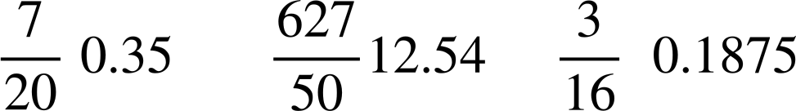






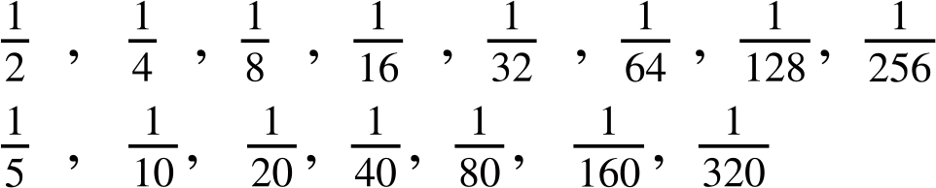
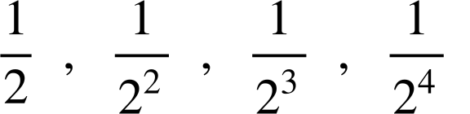
Converting fractions to terminating decimals
Task A: Recognising terminating and non-terminating
1) Without a calculator, calculate the decimal value of the following fractions:
a)
d)
b)
e)
c)
f)
is not equivalent to a terminating decimal.
Lucas says
The prime factors of the denominator are 2, 3 and 11.
2) Explain
why
is equivalent to a terminating decimal.
Lucas needed to simplify the fraction
3) Jacob has discovered all these denominators will give a terminating decimal.
Can you explain why?
All of the denominators only have a prime factor base of 2, so all are factors of powers of 10.
....

Slide 2




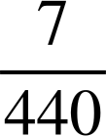





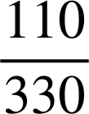
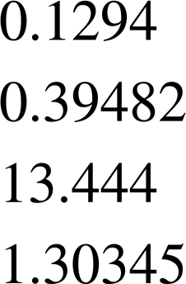
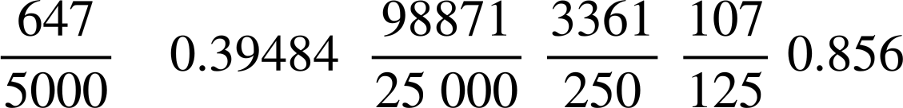

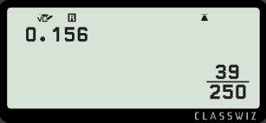
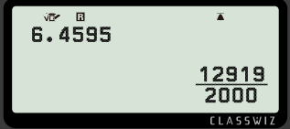
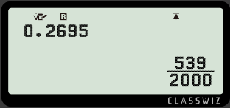
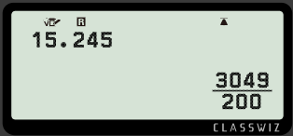
Converting fractions to terminating decimals
4) Circle all the terminating decimals.
Task B: Using a calculator
1) Using a calculator, match the fraction to its terminating decimal.
2) Find the missing value(s) on the calculator displays.
Mathematics in Education and Industry
v2.2

